Slide 1

Structuring Metadata for Reuse Building Foundational Metadata
Marion Wittenberg – DANS
Merja Karjalainen – SND

Slide 2
Contributors
Alerk Amin - Centerdata
Johan Fihn - SND
Larry Hoyle - University of Kansas
Merja Karjalainen - SND
Hilde Orten - NSD
Bodil Stenvig _ DDA
Joachim Wackerow - GESIS
Marion Wittenberg - DANS

Slide 3
Structuring Metadata for Reuse Building Foundational Metadata
Work in progress
DDI Working Paper Series – Longitudinal Best Practice II, No. 2
This paper is part of a series that focuses on DDI usage and how the metadata specification should be applied in a variety of settings by a variety of organizations and individuals. Support for this working paper series was provided by the authors’ home institutions; by GESIS - Leibniz Institute for the Social Sciences; by Schloss Dagstuhl - Leibniz Center for Informatics; and by the DDI Alliance.

Slide 4
Reuse of metadata
better support for comparability between different studies
facilitating the management of references to classifications and other resources
Foundational Metadata - metadata that are agreed as de facto standards

Slide 5
Publishing Metadata using Resource Packages
Exclusive publication of reusable items outside the context of a study
All identifiable items can be reused
Elements that use a scheme are better candidates for reuse.
Examples:
Category
Code
Concept
Question
Universe
Variable

Slide 6
Classifications
Reuse of a combination of Variable, Code and Categories
Separate presentation of Hilde Orten and Joachim Wackerow
The ISCED Standard for Coding of Education and DDI-Lifecycle

Slide 7
Customization of Published Items
the reusable item/element can be referenced by the user to be used in the original form
or
it can be customized to fit into the purpose of the user

Slide 8
Steps to Customize a DDI Scheme
Two different mechanisms for doing this:
One mechanism applies to Categories, Concepts, Questions, Universes, and Variables
The other mechanism applies only to Codes, as DDI implements the CodeMap differently than the other maps.

Slide 9
Customizing a CategoryScheme, ConceptScheme, QuestionScheme, UniverseScheme, or VariableScheme
Create a new Scheme of the appropriate type
Use a SchemeReference to include the original scheme
Use Exclude for items that are removed
Add new items to the customized scheme
Modify items. As there is no explicit way to document a modification in DDI, the solution is to exclude the original item, add the customized item, and document the modifications between these two elements.
Create Comparison elements to document items that are excluded/added/modified

Slide 10
Customizing a CodeScheme
Create a new CodeScheme of the appropriate type
Use a CodeSchemeReference to include the original scheme
List the items that are reused without modification in the customized scheme
Add new items to the customized scheme
Modify items. As there is no explicit way to document a modification in DDI, the solution is to exclude the original item, add the customized item, and document the modifications between these two elements.
Create Comparison elements to document items that are excluded/added/modified

Slide 11
How to Reference Elements in a Customized Scheme
Customized scheme can contain a mix of unmodified elements from the original scheme, and the new/modified elements.
Unmodified elements > refer to the ID/URN in the original scheme
New/modified element > refer to the ID/URN in the customized scheme, with the new agency.

Slide 12
Example: Use of a Question Bank
Reuse of individual questions
reuse without any customizations
re-use with customizations
Reuse of a battery of questions

Slide 13
Reuse of individual questions
Without any customizations > reference the QuestionItem directly from his QuestionConstruct
Re-use with customizations >
Create a new QuestionScheme
Add a new QuestionItem using the same metadata as the original QuestionItem, but add the translation. This new QuestionItem will be a customized copy of the original QuestionItem, but have a new ID.
Create Comparison elements to document the new customized QuestionItem

Slide 14
Reuse a battery of questions
Create a new QuestionScheme, a new ControlConstructScheme and a new InterviewerInstructionScheme
Use QuestionSchemeReference, ControlConstructSchemeReference and InterviewerInstructionSchemeReference to include the original schemes
Use Exclude for any QuestionItems, QuestionConstructs or Instructions that are removed
Add any additional QuestionItems, QuestionConstructs or Instructions to the new schemes.
Modify the items which should be translated, e.g. QuestionItem or Instruction
Exclude the original QuestionItem or Instruction as described above
Add new QuestionItems or Instructions with the new translations as described in step 4 of the generic model.
Use the Comparison element to document the modifications. This is described in the following step.
Create Comparison elements to document the QuestionItems or Instructions that have been modified.

Slide 15
Limitations in DDI regarding the use of Question Banks (1)
No support in DDI for referencing Concepts for an entire ControlConstructScheme (block of questions)
There is no Include element in QuestionSchemeReference
There is no Exclude element in CodeSchemeReference
The definition of a QuestionScheme should change from (QuestionItem | MultipleQuestionItem)+ to
(QuestionItem | MultipleQuestionItem)*

Slide 16
Limitations in DDI regarding the use of Question Banks (2)
In ItemMap, the SourceItem and TargetItem should be references (including a version)
It is not possible to include a Comparison element in a StudyUnit. Ideally, you would also include a QuestionMap in a QuestionScheme
IncludedCodeReference is currently a string, but it should be something better for referring to a specific item/version.
It is not possible to “extend”/”modify” elements

Slide 17
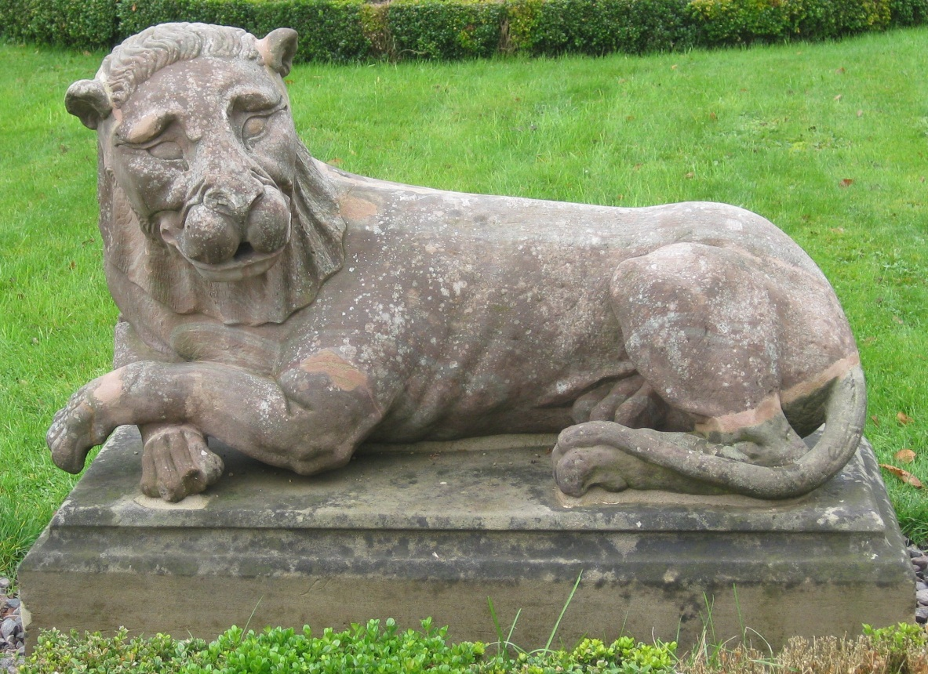
Thank you! Any questions?

